Slide 1



Cdr Vijay Pratap Singh,
Adjunct Professor

Slide 2





























Slide 3
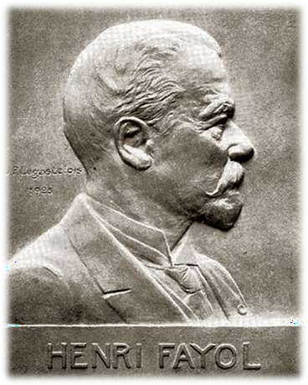
HENRI FAYOL
“EFFECTIVENESS IS A FUNCTION OF CLEAR AUTHORITY AND DISCIPLINE WITHIN AN
ORGANIZATION”

Slide 4


What is Organizational?
Derived from the Greek word “organon”,
As we know `organ` - and it means a compartment for a particular job.
An organization is a social group which
distributes tasks for a collective goal.
Division work
Organizational structure is adopted.

Slide 5


What is Effectiveness?
The degree to which objectives are achieved and the extent to which targeted problems are solved.
Effectiveness means "doing the right thing."

Slide 6


ORGANIZATIONAL EFFECTIVENESS
“Organizational effectiveness is the concept of how effective an organization is in achieving the outcomes the organization intends to produce.

Slide 7




METHODS TO MEASURING THE EFFECTIVENESS OF THE ORGANIZATION
Goal Approach;
Internal Process Approach;
System Resource Approach;
Strategic Approach

Slide 8


METHODS TO MEASURING THE EFFECTIVENESS OF THE ORGANIZATION
Goal Approach:
Effectiveness is the ability to excel at one or
more output goals.
Internal Process Approach: Effectiveness is the ability to excel at internal efficiency, coordination, motivation, and employee satisfaction.

Slide 9




Approaches to Measuring Org. Effectiveness, continued
C. System Resource Approach: Effectiveness is the ability to acquire scarce and valued resources from the environment.
D. Strategic Approach: Effectiveness is the ability to satisfy multiple strategic constituencies both within and outside the organization.

Slide 10











Approach | Definition | When Used
 | An organization is effective to the extent that: | Preferred when:
Goal Approach | it accomplishes its stated goals | goals are clear, time bound and measurable
System Resource | it acquires needed resources | a clear connection exists between inputs and outputs
Strategic Approach | all strategic constituencies are at least minimally satisfied | constituencies have powerful influence on the organization, and the organization must respond to demands
Internal Processes | combines internal efficiency and affective health | costs, outputs & satisfaction are easily measurable

Slide 11





Improved:
profitability
competitiveness
customer satisfaction
management-employee relations
focus on key goals
communications
teamwork
employee morale
company image
revenue
service to customers (internal &
external)
effectiveness
planning
work environment
decision making
Reduced:
customer complaints
warranty claims
cost
waste
rework
employee turn-over
Increased:
employee involvement
employee satisfaction
ability to attract new customers
Greater:
market share
adaptability

Slide 12





Conclusion
Organizational effectiveness is the degree of achievements of an organizational objectives.
They are mainly 4 types of methods to measuring the effectiveness;
Goal Approach
Behavioral
System resource
Strategic R. Approach

Slide 13




